Slide 1
Software Requirement Engineering
Organizing Requirements
Muhammad Nasir
m.nasir@iiu.edu.pk

Slide 2
Outline
Problem vs. Solution space
Requirement’s Pyramid
Organizing Requirements
Sub-Systems & Requirements
Organizing Requirements for Product Families

Slide 3
Organizing Requirements
We'll continue to focus on the features we identified earlier.
We must also start to provide additional specifications to further define system behavior
Thus, the amount of information we must manage increases.

Slide 4
Problem vs. Solution space
In addition, we must be concerned with a variety of other issues that are unique to the solution space but that were of little concern in the problem domain.
For example, packaging, installation, and licensing considerations, each of which may be unique to the solution we are providing.

Slide 5
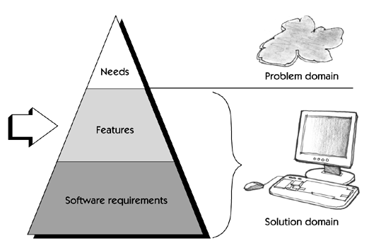
Requirement’s Pyramid

Slide 6
Defining the System
Use-case can be used to represent system features
Use-cases carry the majority of the requirements for the system.
Use-cases later drive test-cases development.

Slide 7
Defining the System
Requirements can be defined at:
  System Level
  Sub-system Level

Slide 8
System Level Requirements
Some systems are sufficiently complex that the only reasonable way to visualize and to build them is as a system of subsystems
Such as an aircraft-carrier, the system may be composed of hundreds of subsystems (Missile Defense System, Cannon, Radar System, Cruise Control etc.), each in turn having hardware and software components.

Slide 9
System Level Requirements
In these cases, a system-level requirements set is created that describes the system,
Such as fuel-capacity, number and types of aircraft carried and number of sorties flown per day, as well as the system-level use cases that describe functional behavior,
without knowledge of or reference to any of its subsystems.

Slide 10
Sub-Systems Requirements
Once the requirements for the system are agreed on, a further systems engineering activity is performed.
Systems engineering refines a system into subsystems describing the detailed interfaces among the subsystems
and allocating each of the system-level requirements to one or more subsystems.
Notes:
Systems engineering is an interdisciplinary field of engineering and engineering management that focuses on how to design and manage complex systems over their life cycles.

Slide 11
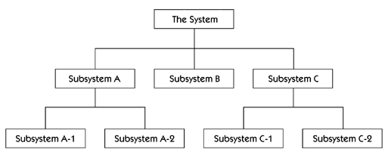
Sub-Systems Requirements

Slide 12
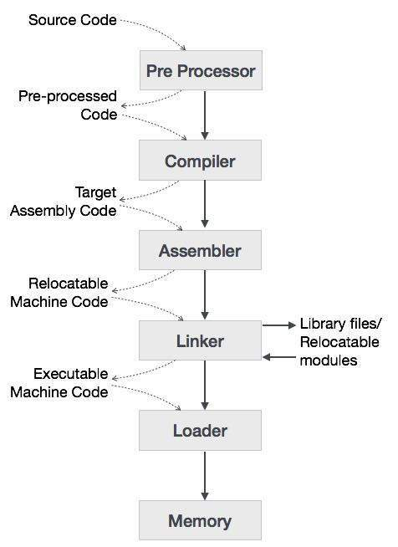
Compiler System

Slide 13
Sub-Systems Requirements
Next, requirements are developed for each subsystem.
These should describe the external behavior of the subsystem completely, without reference to any of its subsystems.
In particular, the interfaces among these subsystems become key requirements

Slide 14
Sub-Systems Requirements
Once these requirements are agreed on, system design is performed again,
if necessary, by breaking down each of the subsystems into its subsystems and developing requirements for each

Slide 15
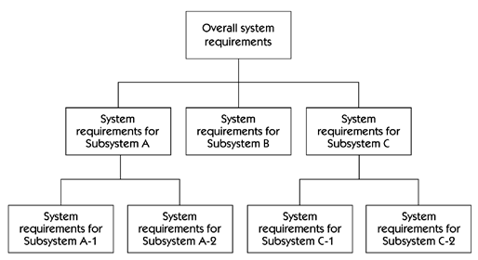
Sub-Systems Requirements

Slide 16
Sub-Systems Requirements
At every level, requirements from the previous level are allocated to the appropriate lower-level systems.
For example, the fuel capacity requirement is allocated to the fuel control subsystem and to the fuel storage subsystem,
and new requirements are discovered and defined as appropriate.

Slide 17
Organizing Requirements for Product Families
Many industries build sets of closely related products that have much functionality in common,
Yet each product contains some unique features, i.e., .NET Framework, MS Office suite

Slide 18
Organizing Requirements for Product Families
each with some shared functionality, that may need to share data or otherwise communicate with one another when in use.

Slide 19
Organizing Requirements for Product Families
In such a case, you might organize your requirements set with the following approach.
To better understand the shared-usage model, you might also develop a set of use-cases showing how the users will interact with various applications running together.

Slide 20
Organizing Requirements for Product Families
Develop a common software requirements for shared functionality,
such as menu structures, common GUIs, and communication protocols.
Develop a supplementary specification, and a use-case model that defines its specific functionality.

Slide 21
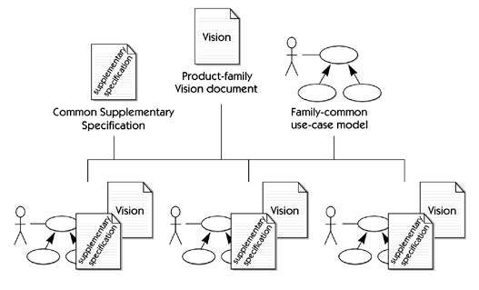
Organizing Requirements for Product Families

Slide 22
The End
Thanks for listening
Questions would be appreciated.

